Slide 1
Compiler Construction

Slide 2
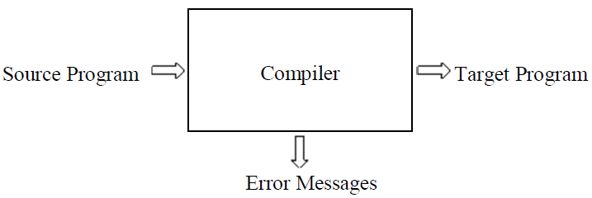
The Structure of a Compiler
A compiler is a program that takes a program written in a source language and translates it into an equivalent program in a target language.
Compiler operates in Phases.
Each phase transforms the source program from one representation into another representation.
Notes:
They communicate with error handlers.
They communicate with the symbol table.

Slide 3
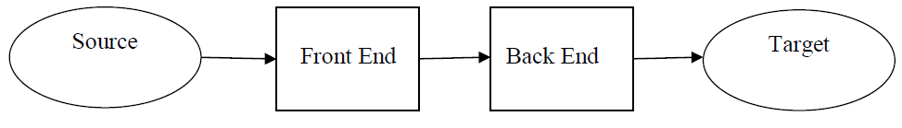
The Structure of a Compiler (contd.)
There are two parts to compilation:
Analysis (front end)
Machine independent / Language dependent phase
Read the source program and understands its structure and meaning.
Creates an intermediate representation (IR) of the source program.
Synthesis (back end)
Machine dependent / Language independent phase
Constructs the desired target program from the intermediate representation and the information from the symbol table.
Notes:
The first four phases, forms the bulk of the analysis portion of a compiler.
Code Optimization is an optional phase
Synthesis part consists of Code Generator phase.

Slide 4
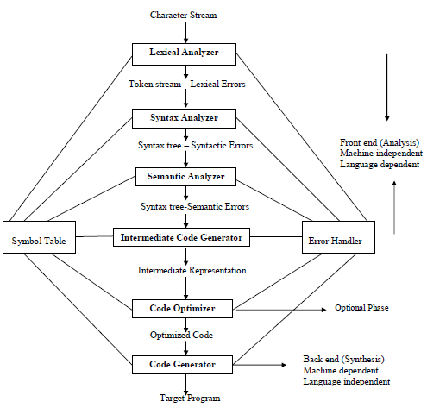
The Structure of a Compiler (contd.)

Slide 5
Phase 1: Lexical Analyzer (Scanner)
The Structure of a Compiler (contd.)
Lexical Analyzer reads the source program character by character and groups the characters into meaningful sequences called lexemes.
For each lexeme, the lexical analyzer produces a token.
Token form: <token-name, attribute-value>
  token-name is an abstract symbol that is used during syntax analysis
  attribute-value points to an entry in the symbol table for this token.
Puts information about identifiers into the symbol table.
Notes:
The primary functions of this phase are:
Identify the lexical units in a source code
Classify lexical units into classes like constants, reserved words, and enter them in different tables. It will Ignore comments in the source program
Identify token which is not a part of the language

Slide 6
Phase 1: Lexical Analyzer (contd.)
The Structure of a Compiler (contd.)
Example: position = initial + rate * 60
The statement after lexical analysis is given by
<id,1><=><id,2><+><id,3><*><60>
or
id₁=id₂+id₃*60
Position = initial + rate * 60
_______ __ _____ _ ___ _ __
All are lexemes

Slide 7
Phase 2: Syntax Analyzer (Parser)
The Structure of a Compiler (contd.)
Obtain tokens from the lexical analyzer and Checks if the expression is syntactically correct or not
The syntax of a language is specified by a Context Free Grammar.
The parser creates a tree-like intermediate representation that depicts the grammatical structure of the token stream.
A syntax analyzer checks whether a given program satisfies the rules implied by a CFG or not.
  If it satisfies, the syntax analyzer creates a syntax tree for the given program.
A syntax tree for the token stream id1=id2+id3*60 is
:=
id₁
+
id₂
*
id₃
60
Notes:
Here, is a list of tasks performed in this phase:
Obtain tokens from the lexical analyzer
Checks if the expression is syntactically correct or not
Report all syntax errors
Construct a hierarchical structure which is known as a parse tree

Slide 8
Phase 3: Semantic Analyzer
The Structure of a Compiler (contd.)
A semantic analyzer checks the source program for semantic errors
Type-checking is an important part of semantic analyzer .
The language specification may permit some type conversions called coercions.
Suppose that position, initial, and rate have been declared to be floating-point numbers
:=
id₁
+
id₂
*
id₃
inttofloat
60
Notes:
Functions of Semantic analyses phase are:
Helps you to store type information gathered and save it in symbol table or syntax tree
Allows you to perform type checking
In the case of type mismatch, where there are no exact type correction rules which satisfy the desired operation a semantic error is shown
Collects type information and checks for type compatibility
Checks if the source language permits the operands or not

Slide 9
Phase 4: Intermediate Code Generation
The Structure of a Compiler (contd.)
A compiler may produce an explicit intermediate codes representing the source program.
This IR should have two important properties: it should be easy to produce and it should be easy to translate into the target program.
Three-address code consists of a sequence of assembly-like instructions with three operands per instruction.
The output of the intermediate code generator consists of the three-address code sequence
t₁=inttofloat(60)
t₂= id₃* t₁
t₃= id₂+ t₂
id₁= t₃

Slide 10
Phase 5: Code Optimizer
The Structure of a Compiler (contd.)
The code optimizer optimizes the code produced by the intermediate code generator in the terms of time and space.
It reduces the code by removing repeated or unwanted instructions from the intermediate code.
The intermediate code produced by the intermediate code generator can be optimized to the following code.
t₁=id₃*60.0
id₁=id₂+t₁

Slide 11
Phase 6: Code Generator
The Structure of a Compiler (contd.)
Produces the target language in a specific architecture.
The code generator takes as input an intermediate representation of the source program and maps it into the target language.
Code generation is a mapping from source level abstractions to target level abstractions.
  Abstractions at the source level: Identifiers, operators, statements, functions etc.
  Abstractions at the target level: Memory locations, registers, stacks, opcodes, addressing modes etc.
Using registers R₁ and R₂, the above intermediate code might get translated into the following code
LDF R₂, id₃
MULF R₂, #60.0
LDF R_{l}, id₂
ADDF R_{l}, R₂
STF id₁, R_{l}

Slide 12
Reviewing the Entire Process
The Structure of a Compiler (contd.)
position := initial + rate * 60
Lexical Analyzer (Scanner)
id₁ := id₂ + id₃ * 60
Syntax Analyzer (Parser)
:=
id₁
+
id₂
*
id₃
60
Semantic Analyzer
:=
Symbol Table
id₁
+
Error
Handler
id₂
*
1 position ....
2 initial ….
3 rate….
id₃
inttofloat
60
Intermediate Code Generator

Slide 13
Reviewing the Entire Process
The Structure of a Compiler (contd.)
Symbol Table
1 position ....
2 initial ….
3 rate….
Error
Handler
Intermediate Code Generator
t₁ := inttofloat(60)
t₂ := id₃ * t₁
t₃ := id₂ + t₂
id₁ := t₃
Three address code
Code Optimizer
t₁ := id₃ * 60.0
id₁ := id₂ + t₁
Code Generator
LDF R₂, id₃
MULF R₂, #60.0
LDF R₁, id₂
ADDF R₁, R₂
STF id₁, R₁

Slide 14
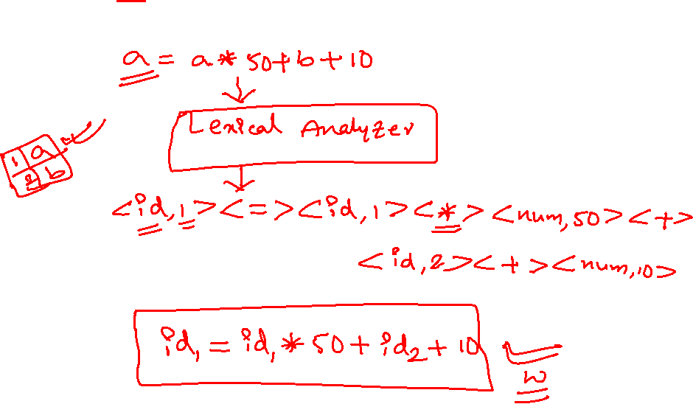

Slide 15
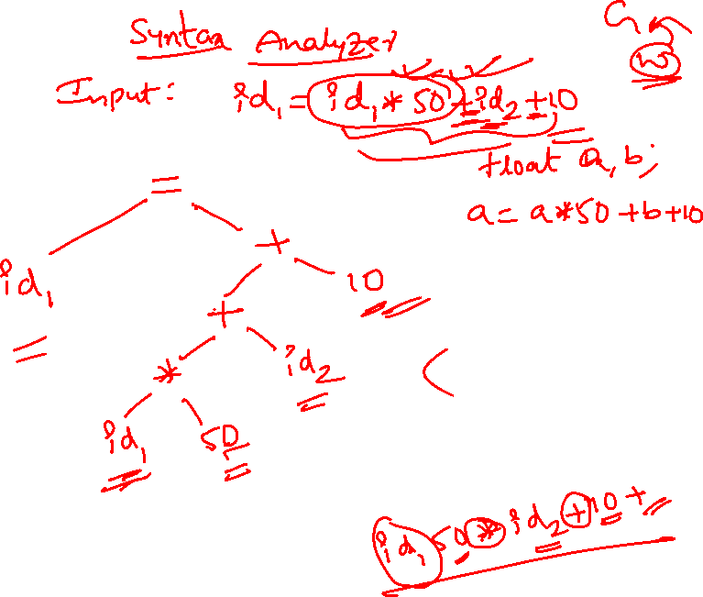

Slide 16
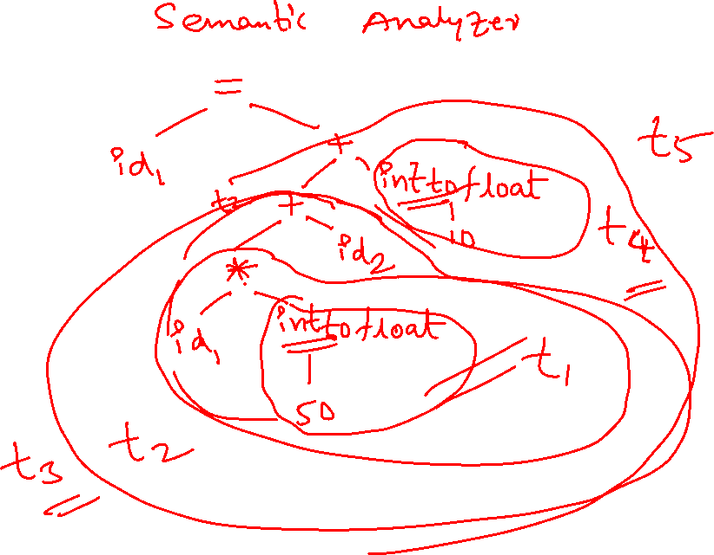

Slide 17
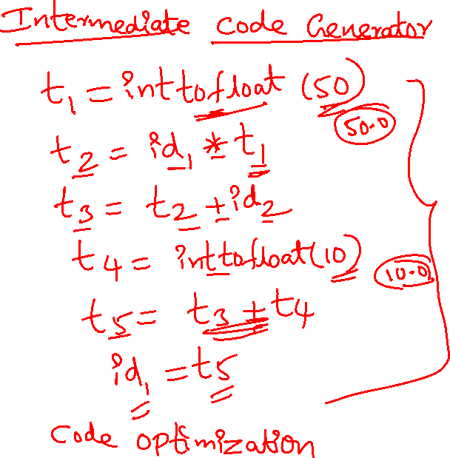

Slide 18
